Slide 1
UART
(NVIC)
THROTTLE
S_{BUS}
PITCH
R_{x}
ROLL
YAW
FLIGHT CONTROLLER
(CH.5)
MICROCONTROLLER

Slide 2
DA
CL
Camera Module
MICROCONTROLLER

Slide 3
V_{x2}
.
.
V_{x1}
V
o'
o
V_{y1}
V_{y2}

Slide 4
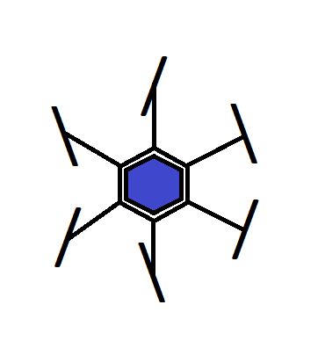
L1
L2

